Slide 1
MET CS 555 – Foundations of Machine Learning Lecture 11: One and Two-Sample Test of Proportion
Hongsheng Wu
Boston University

Slide 2
Study Guide
One-Sample Tests for Proportions
Two-Sample Tests for Proportions

Slide 3

One-Sample Tests for Proportions

Slide 4
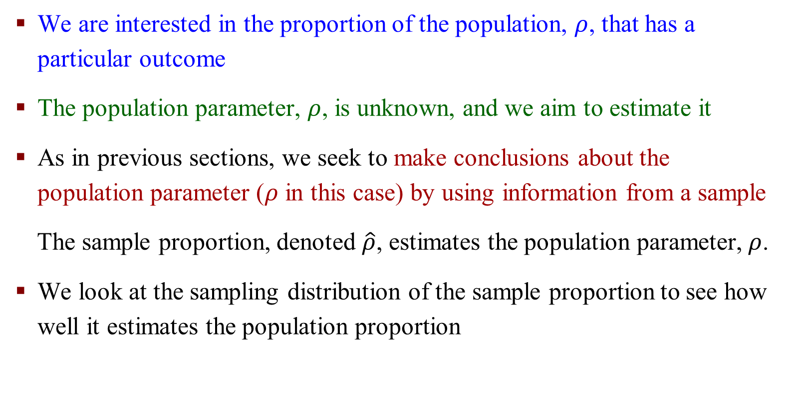
One-Sample Tests for Proportions
We are interested in the proportion of the population, $ρ$, that has a particular outcome
The population parameter, $ρ$, is unknown, and we aim to estimate it
As in previous sections, we seek to make conclusions about the population parameter ($ρ$ in this case) by using information from a sample
The sample proportion, denoted $\hat{ρ}$, estimates the population parameter,$ρ$.
We look at the sampling distribution of the sample proportion to see how well it estimates the population proportion

Slide 5
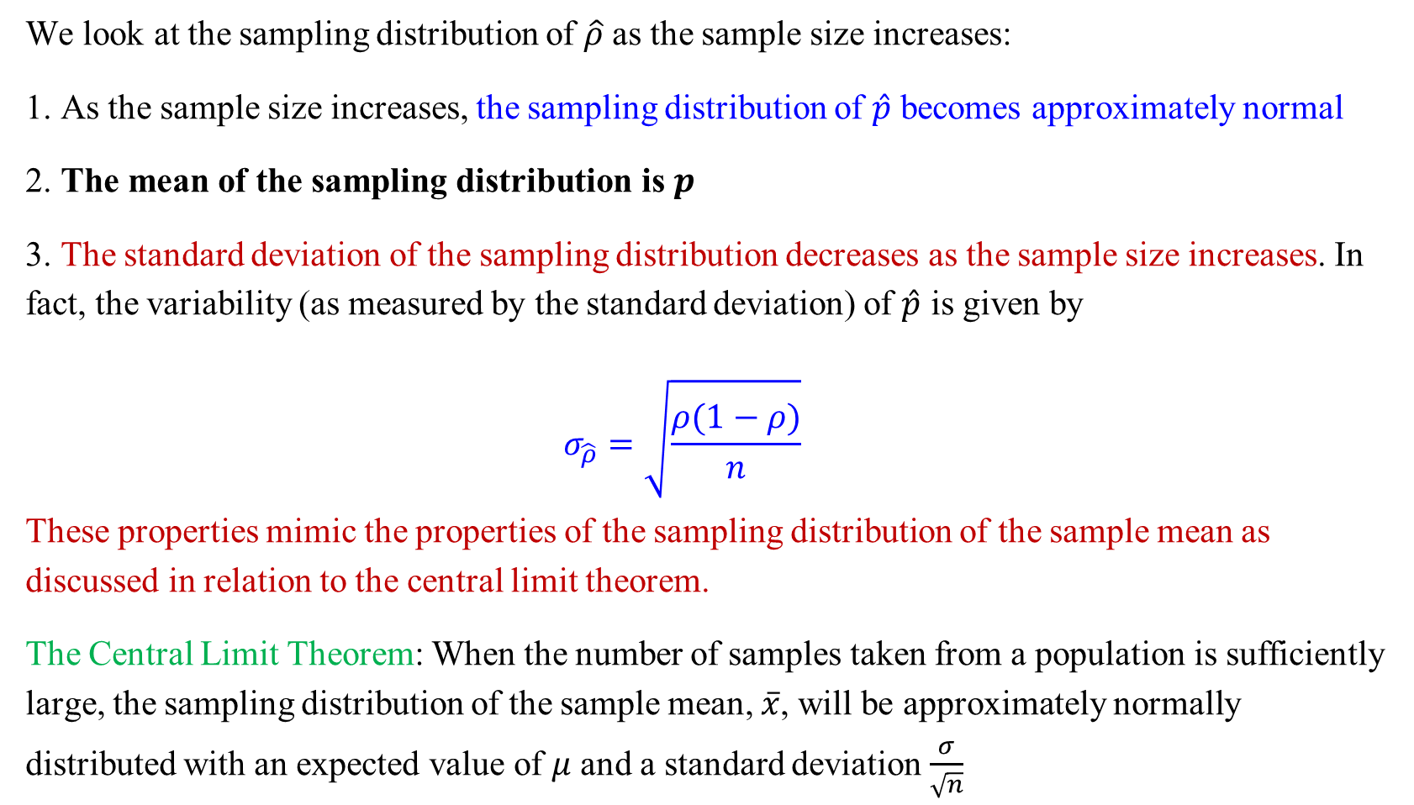
One-Sample Tests for Proportions
We look at the sampling distribution of $\hat{ρ}$ as the sample size increases:
1. As the sample size increases, the sampling distribution of $\hat{p}$ becomes approximately normal
2. The mean of the sampling distribution is $p$
3. The standard deviation of the sampling distribution decreases as the sample size increases. In fact, the variability (as measured by the standard deviation) of $\hat{p}$ is given by
$$σ_{\hat{ρ}}=\sqrt{\frac{ρ(1−ρ)}{n}}$$
These properties mimic the properties of the sampling distribution of the sample mean as discussed in relation to the central limit theorem.
The Central Limit Theorem: When the number of samples taken from a population is sufficiently large, the sampling distribution of the sample mean, $\overline{x}$, will be approximately normally distributed with an expected value of $μ$ and a standard deviation $\frac{σ}{\sqrt{n}}$

Slide 6
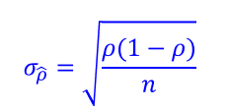
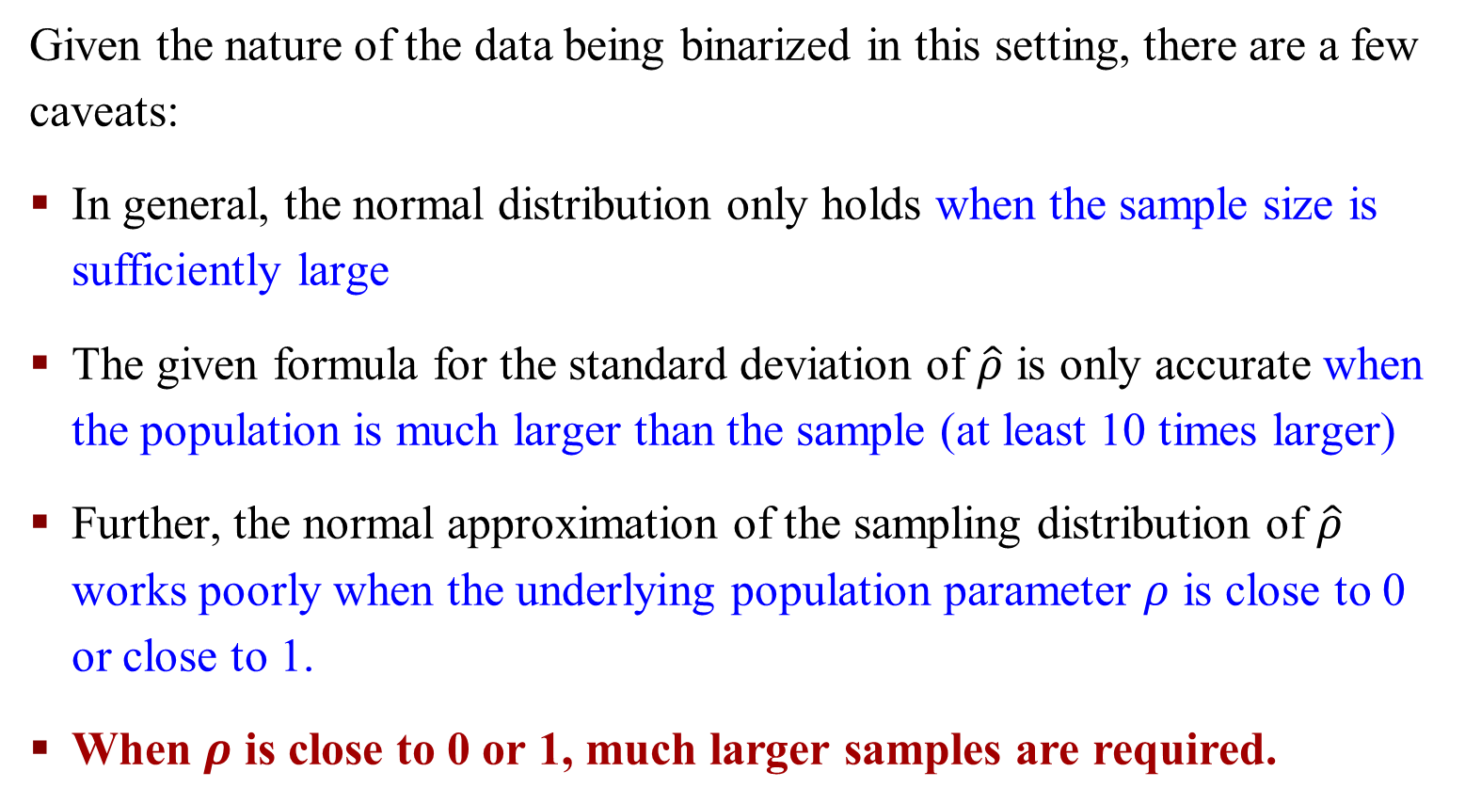
A Few Caveats
Given the nature of the data being binarized in this setting, there are a few caveats:
In general, the normal distribution only holds when the sample size is sufficiently large
The given formula for the standard deviation of $\hat{ρ}$ is only accurate when the population is much larger than the sample (at least 10 times larger)
Further, the normal approximation of the sampling distribution of $\hat{ρ}$ works poorly when the underlying population parameter $ρ$ is close to 0 or close to 1.
When $ρ$ is close to 0 or 1, much larger samples are required.

Slide 7
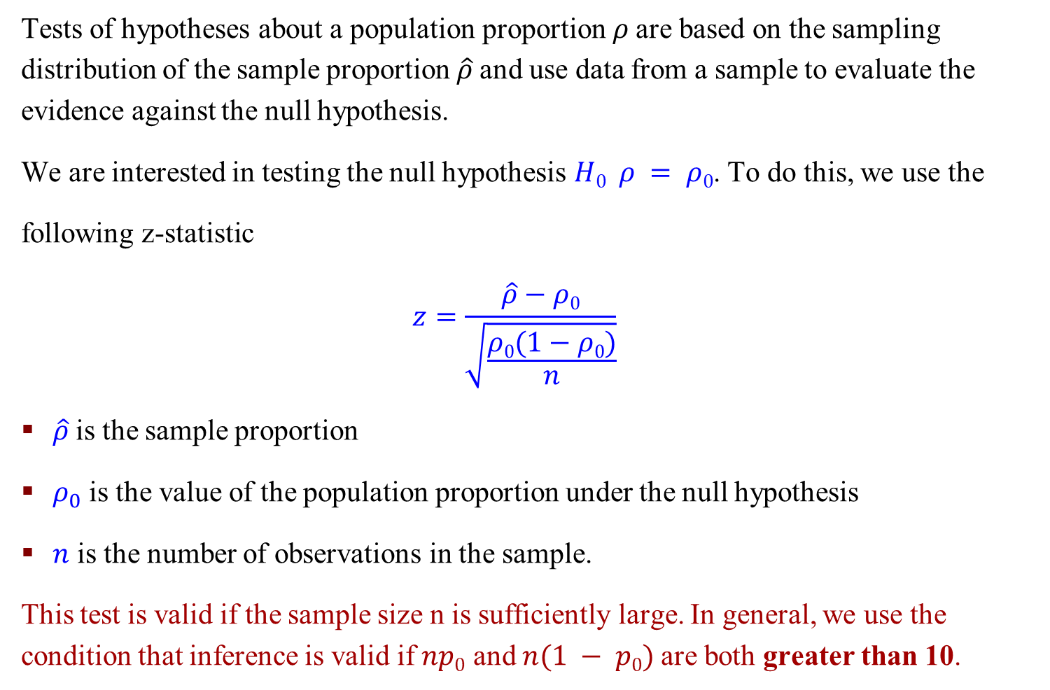
Significance Tests for a Proportion
Tests of hypotheses about a population proportion 𝜌 are based on the sampling distribution of the sample proportion $\hat{ρ}$and use data from a sample to evaluate the evidence against the null hypothesis.
We are interested in testing the null hypothesis $H0 ρ = ρ0$. To do this, we use the
following z-statistic
$$z=\frac{\hat{ρ}−ρ0}{\sqrt{\frac{ρ0(1−ρ0)}{n}}}$$
$\hat{ρ}$is the sample proportion
$ρ_{0}$ is the value of the population proportion under the null hypothesis
$n$ is the number of observations in the sample.
This test is valid if the sample size n is sufficiently large. In general, we use the condition that inference is valid if $np0$ and $n(1 − p0)$are both greater than 10.

Slide 8

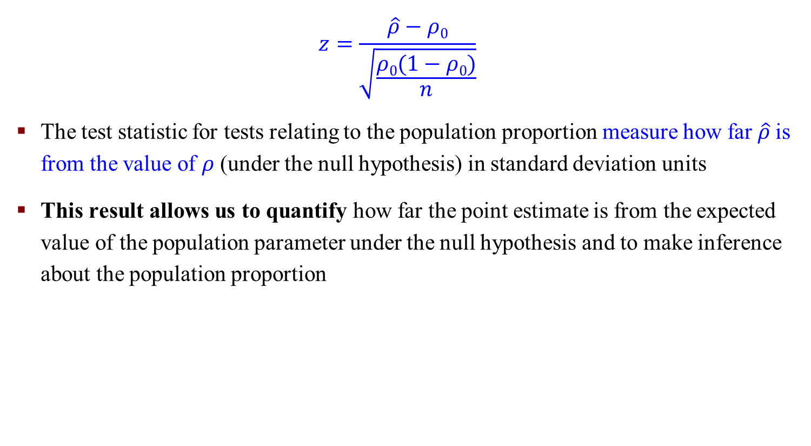
Significance Tests for a Proportion
$$z=\frac{\hat{ρ}−ρ0}{\sqrt{\frac{ρ0(1−ρ0)}{n}}}$$
The test statistic for tests relating to the population proportion measure how far $\hat{ρ}$is from the value of $ρ$ (under the null hypothesis) in standard deviation units
This result allows us to quantify how far the point estimate is from the expected value of the population parameter under the null hypothesis and to make inference about the population proportion
Z-test in mean: $z= \frac{\overline{x}−μ}{\frac{σ}{\sqrt{n}}}$

Slide 9
Significance Tests for a Proportion
This is generally done by calculating the corresponding p-value.
The p-value for the z statistic described above is calculated using the standard normal distribution.

Slide 10
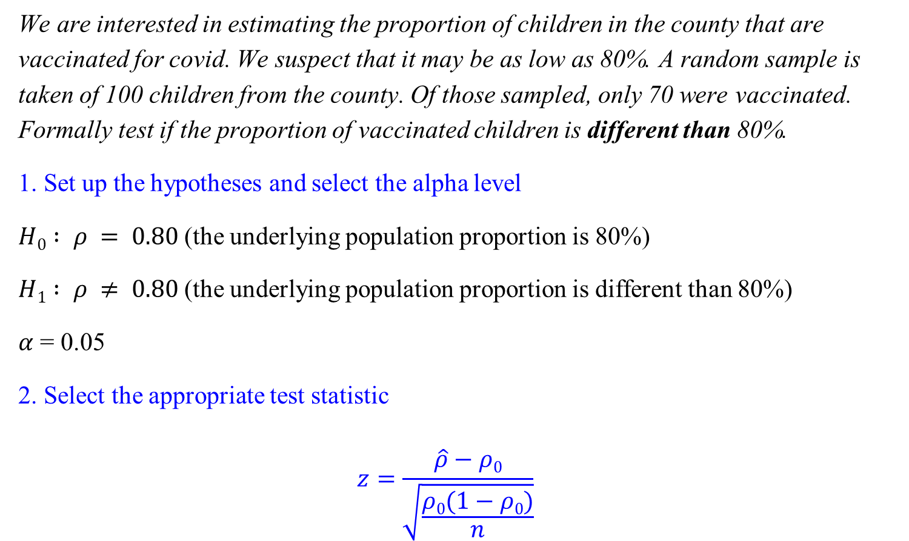
An Example: Significance Tests for a Proportion
We are interested in estimating the proportion of children in the county that are vaccinated for covid. We suspect that it may be as low as 80%. A random sample is taken of 100 children from the county. Of those sampled, only 70 were vaccinated. Formally test if the proportion of vaccinated children is different than 80%.
1. Set up the hypotheses and select the alpha level
$H0 : ρ = 0.80$(the underlying population proportion is 80%)
$H1 : ρ ≠ 0.80$(the underlying population proportion is different than 80%)
$α$ = 0.05
2. Select the appropriate test statistic
$$z=\frac{\hat{ρ}−ρ0}{\sqrt{\frac{ρ0(1−ρ0)}{n}}}$$

Slide 11
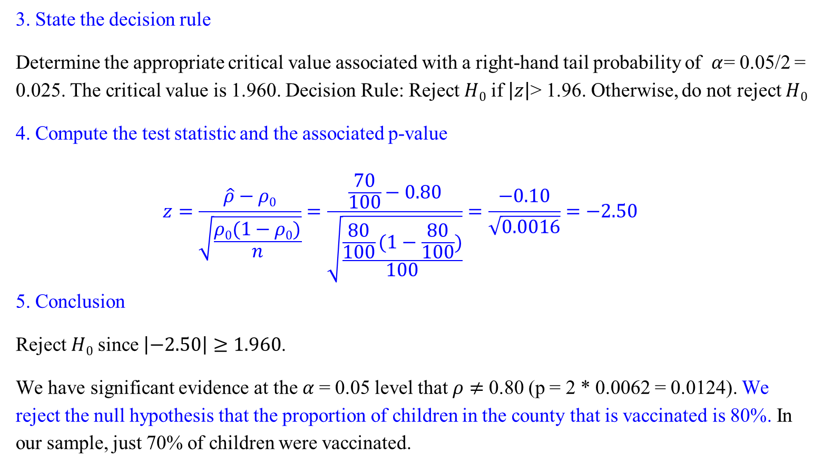
An Example: Significance Tests for a Proportion
3. State the decision rule
Determine the appropriate critical value associated with a right-hand tail probability of $α$= 0.05/2 = 0.025. The critical value is 1.960. Decision Rule: Reject $H0$ if $\left|z\right|$> 1.96. Otherwise, do not reject $H0$
4. Compute the test statistic and the associated p-value
$$z=\frac{\hat{ρ}−ρ0}{\sqrt{\frac{ρ0(1−ρ0)}{n}}}=\frac{\frac{70}{100}−0.80}{\sqrt{\frac{\frac{80}{100}(1−\frac{80}{100})}{100}}}=\frac{−0.10}{\sqrt{0.0016}}=−2.50$$
5. Conclusion
Reject $H0$ since $\left|−2.50\right|≥1.960$.
We have significant evidence at the $α$= 0.05 level that $ρ$ $≠$ 0.80 (p = 2 * 0.0062 = 0.0124). We reject the null hypothesis that the proportion of children in the county that is vaccinated is 80%. In our sample, just 70% of children were vaccinated.

Slide 12

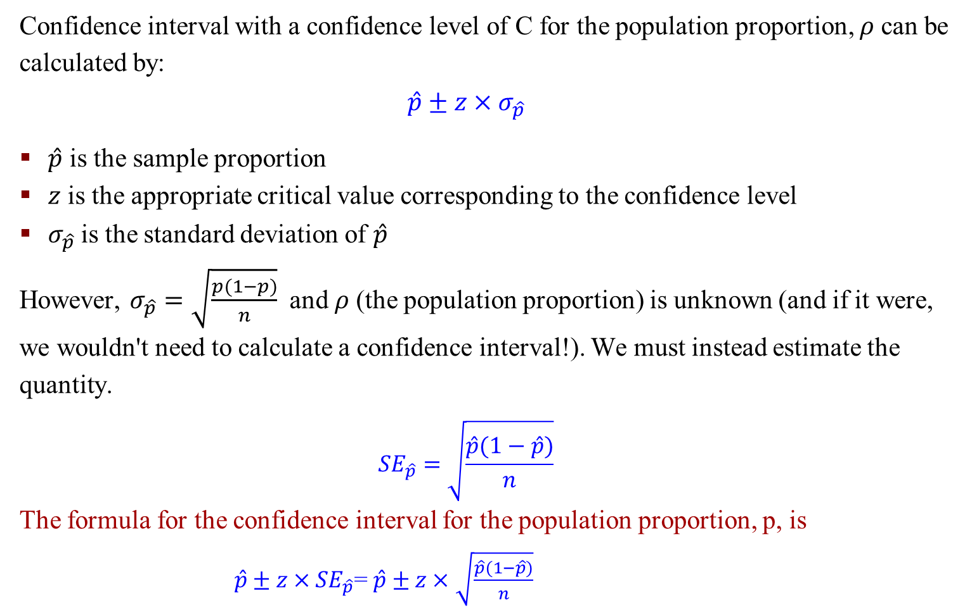
Confidence Intervals for a Proportion
Confidence interval with a confidence level of C for the population proportion, 𝜌 can be calculated by:
$$\hat{p}±z×σ_{\hat{p}}$$
$\hat{p}$ is the sample proportion
$z$ is the appropriate critical value corresponding to the confidence level
$σ_{\hat{p}}$is the standard deviation of $\hat{p}$
However, $σ_{\hat{p}}=\sqrt{\frac{p(1−p)}{n}}$ and 𝜌 (the population proportion) is unknown (and if it were, we wouldn't need to calculate a confidence interval!). We must instead estimate the quantity.
$${SE}_{\hat{p}}=\sqrt{\frac{\hat{p}(1−\hat{p})}{n}}$$
The formula for the confidence interval for the population proportion, p, is
$\hat{p}±z×{SE}_{\hat{p}}$= $\hat{p}±z×$ $\sqrt{\frac{\hat{p}(1−\hat{p})}{n}}$
CI in mean: $\overline{x}±z×\frac{σ}{\sqrt{n}}$

Slide 13
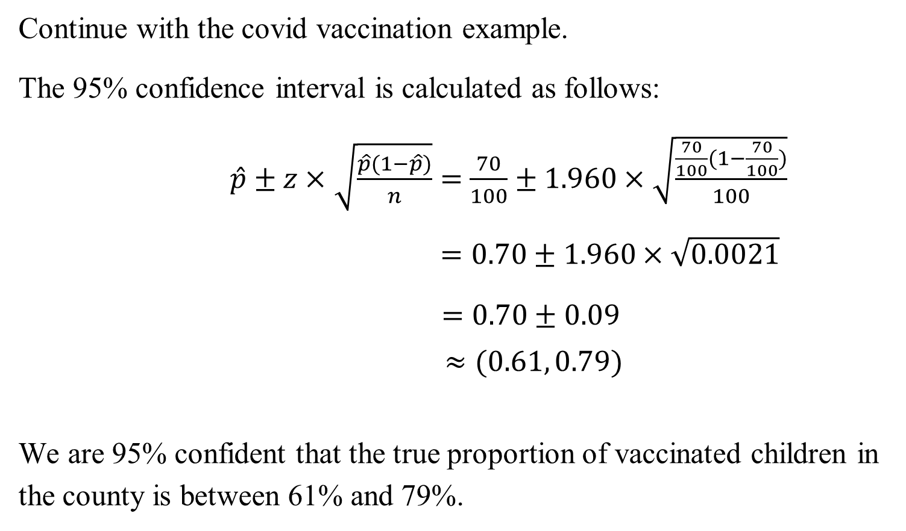
An Example: Confidence Intervals for a Proportion
Continue with the covid vaccination example.
The 95% confidence interval is calculated as follows:
$\hat{p}±z×$ $\sqrt{\frac{\hat{p}(1−\hat{p})}{n}}=$ $\frac{70}{100}±1.960×$ $\sqrt{\frac{\frac{70}{100}(1−\frac{70}{100})}{100}}$
$=0.70±1.960×\sqrt{0.0021}$
$=0.70±0.09$
$≈(0.61, 0.79)$
We are 95% confident that the true proportion of vaccinated children in the county is between 61% and 79%.

Slide 14
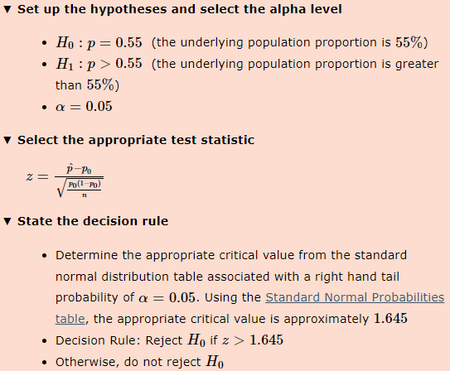
Exercise
A professional basketball player made just 55% of his free throw shots in the previous season. After working specifically with a coach in the off-season, the player is optimistic that he has improved his free throw percentage. In the first few games of the new season, the player made 24 of 40 free throws. Formally test if, at the α=0.05 level whether the player has improved his free throw percentage from last year’s record

Slide 15
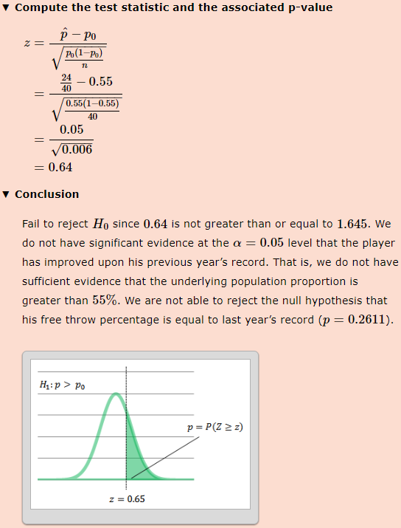

Slide 16
One Sample Tests for a Proportion: R Command
A slight alteration of the formula for the test statistics and the confidence interval makes the test slightly more conservative (and thus, the confidence interval a little wider). It is especially helpful when the sample size is small.
Notes:
conservative保守的

Slide 17
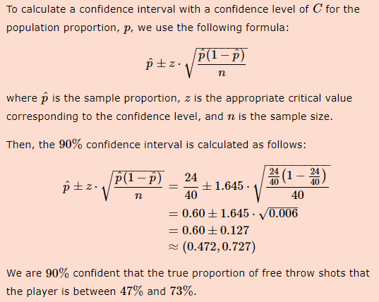
Exercise
In the previous season, a professional basketball player made just 55% of his free throw shots. After working specifically with a coach in the off-season, the player is optimistic that he has improved his free throw percentage. In the first few games of the new season, the player made 24 of 40 free throws. Calculate the 90% confidence interval for the proportion of free throws that the player makes

Slide 18
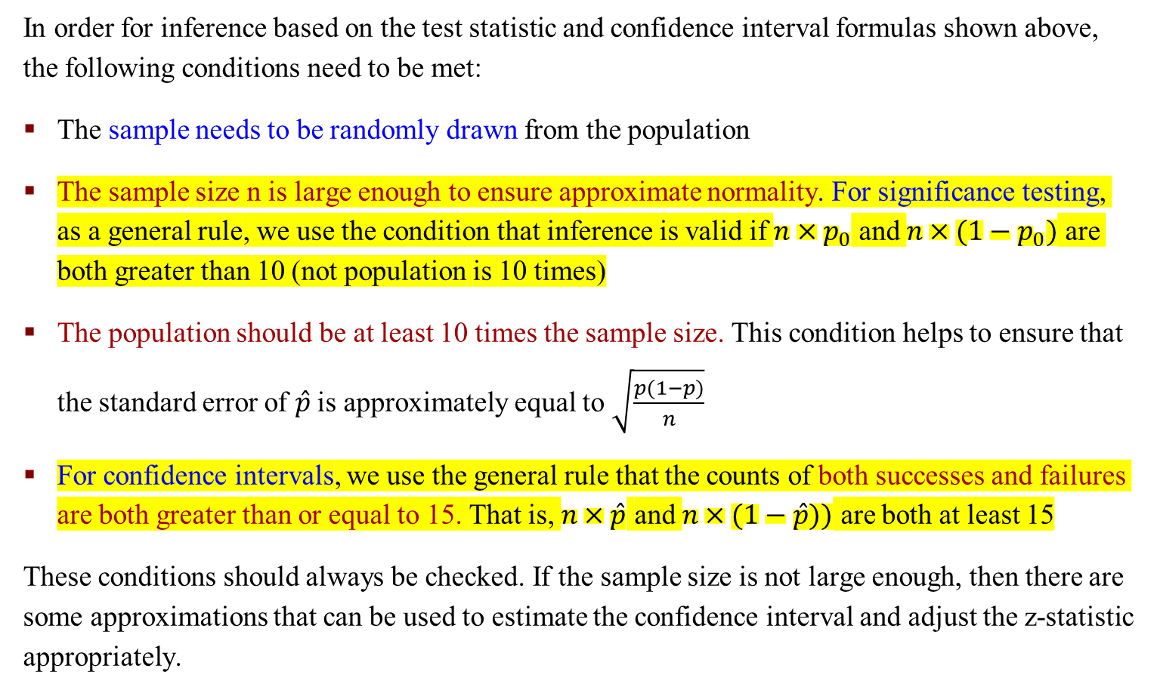
Conditions for Inference
In order for inference based on the test statistic and confidence interval formulas shown above, the following conditions need to be met:
The sample needs to be randomly drawn from the population
The sample size n is large enough to ensure approximate normality. For significance testing, as a general rule, we use the condition that inference is valid if $n×p_{0}$ and $n×{(1−p}_{0})$ are both greater than 10 (not population is 10 times)
The population should be at least 10 times the sample size. This condition helps to ensure that the standard error of $\hat{p}$ is approximately equal to $\sqrt{\frac{p(1−p)}{n}}$
For confidence intervals, we use the general rule that the counts of both successes and failures are both greater than or equal to 15. That is, $n×\hat{p}$ and $n×(1−\hat{p}))$ are both at least 15
These conditions should always be checked. If the sample size is not large enough, then there are some approximations that can be used to estimate the confidence interval and adjust the z-statistic appropriately.

Slide 19
Two-Sample Tests for Proportions

Slide 20
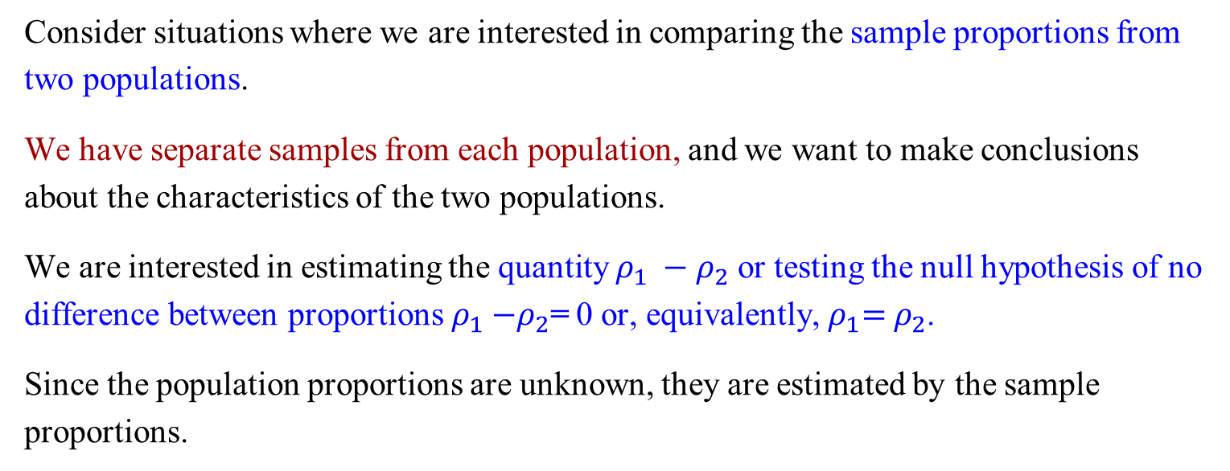
Two-Sample Tests for Proportions
Consider situations where we are interested in comparing the sample proportions from two populations.
We have separate samples from each population, and we want to make conclusions about the characteristics of the two populations.
We are interested in estimating the quantity $ρ_{1} −ρ_{2}$ or testing the null hypothesis of no difference between proportions${ ρ}_{1} −ρ_{2}$= 0 or, equivalently,${ ρ}_{1}={ ρ}_{2}$.
Since the population proportions are unknown, they are estimated by the sample proportions.

Slide 21

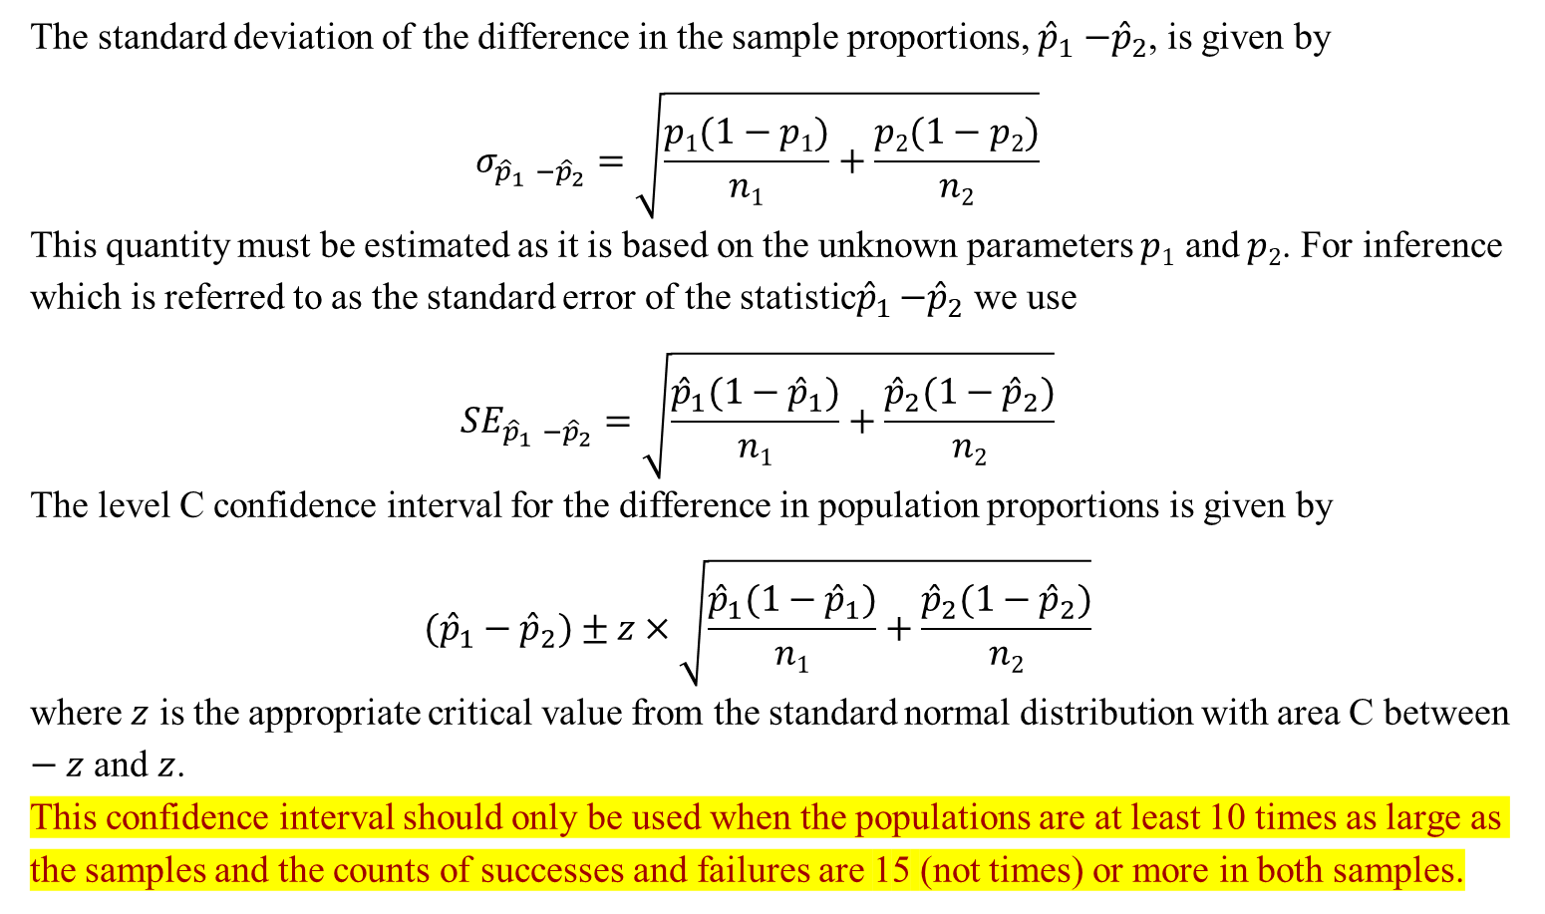
Confidence Intervals for Differences in Proportions
The standard deviation of the difference in the sample proportions, ${\hat{p}}_{1}$ $−{\hat{p}}_{2}$, is given by
$$σ_{{\hat{p}}_{1} −{\hat{p}}_{2}}=\sqrt{\frac{p1(1−p1)}{n1}+\frac{p2(1−p2)}{n2}}$$
This quantity must be estimated as it is based on the unknown parameters $p1$ and $p2$. For inference which is referred to as the standard error of the statistic${\hat{p}}_{1}$ $−{\hat{p}}_{2}$ we use
$${SE}_{{\hat{p}}_{1} −{\hat{p}}_{2}}=\sqrt{\frac{{\hat{p}}_{1}(1−{\hat{p}}_{1})}{n1}+\frac{{\hat{p}}_{2}(1−{\hat{p}}_{2})}{n2}}$$
The level C confidence interval for the difference in population proportions is given by
$$({\hat{p}}_{1}−{\hat{p}}_{2})±z×\sqrt{\frac{{\hat{p}}_{1}(1−{\hat{p}}_{1})}{n1}+\frac{{\hat{p}}_{2}(1−{\hat{p}}_{2})}{n2}}$$
where $z$ is the appropriate critical value from the standard normal distribution with area C between $−z$and $z$.
This confidence interval should only be used when the populations are at least 10 times as large as the samples and the counts of successes and failures are 15 (not times) or more in both samples.
$$t=\frac{{\overline{x}}_{1}−{\overline{x}}_{2}}{\sqrt{\frac{s_{1}^{2}}{n_{1}}+\frac{s_{2}^{2}}{n_{2}}}}$$

Slide 22
An Example: Two-Sample Tests for Proportions
An investigator is interested in the long-term effects of preschool programs on low-income children. A study was conducted where two groups of children were followed over time. The first group of 61 children did not attend preschool. The second group of 62 children (from similar areas and with similar backgrounds to those in the first sample) attended preschool as 3- and 4-year-olds. The need for social programs as adults was the outcome of interest. Of the group who did not attend preschool, 49 needed social services (mainly welfare) between the age of 18 and 30. The preschool group, 38, required social services in the same age range.
Calculate the 95% confidence interval for the difference in proportions of adults requiring social services between those who did not attend preschool and those who did.
Let’s define a “success" in this case as requiring social services.

Slide 23
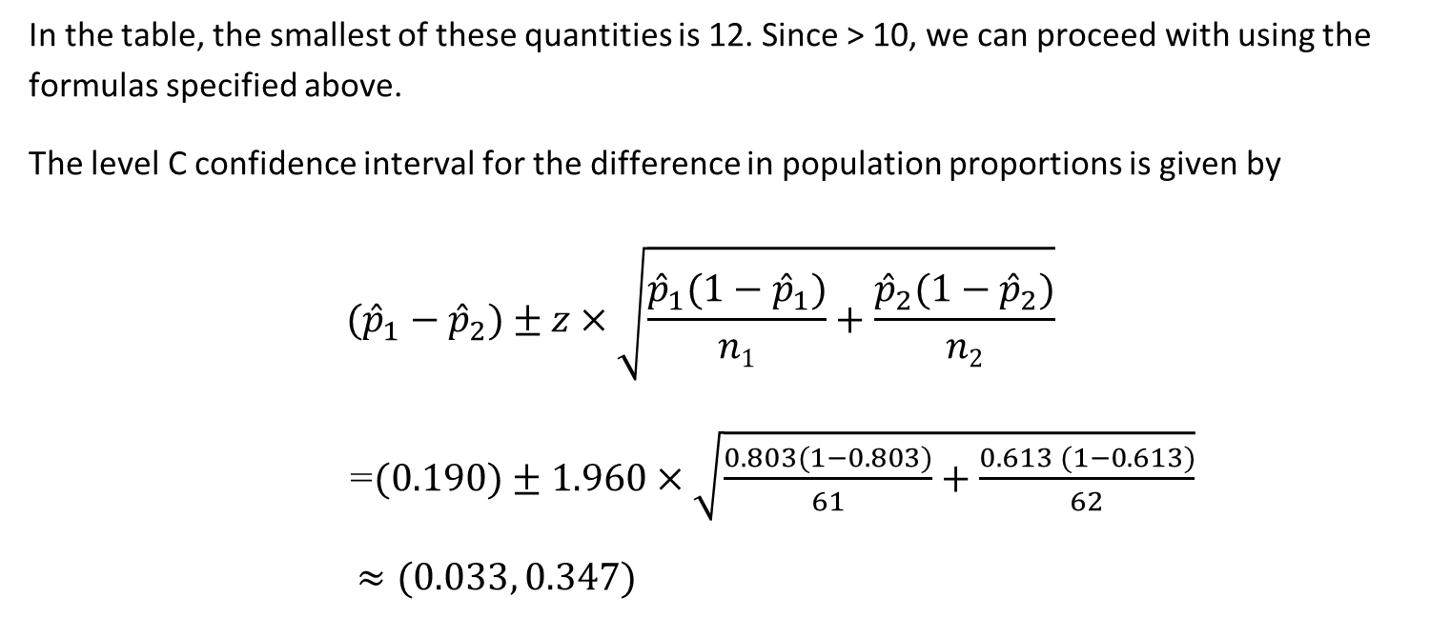
An Example: Two-Sample Tests for Proportions
In the table, the smallest of these quantities is 12. Since > 10, we can proceed with using the formulas specified above.
The level C confidence interval for the difference in population proportions is given by
$$({\hat{p}}_{1}−{\hat{p}}_{2})±z×\sqrt{\frac{{\hat{p}}_{1}(1−{\hat{p}}_{1})}{n1}+\frac{{\hat{p}}_{2}(1−{\hat{p}}_{2})}{n2}}$$
=$(0.190)±1.960×\sqrt{\frac{0.803(1−0.803)}{61}+\frac{0.613 (1−0.613)}{62}}$
$≈(0.033, 0.347)$

Slide 24
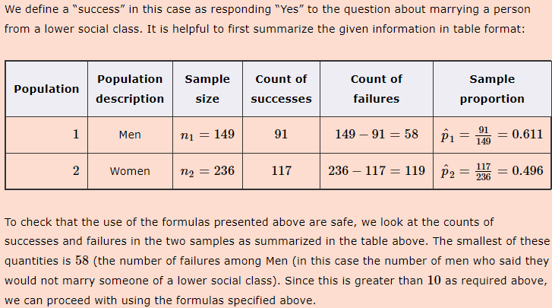
Exercise
Researchers asked randomly selected students in college in the south whether they would marry a person from a lower social class than their own. Of the 149 men asked this question, 91 responded yes while 117 women of the 236 asked responded positively. Calculate the 99% confidence interval comparing the proportion of males versus females who would marry someone from a lower social class.

Slide 25
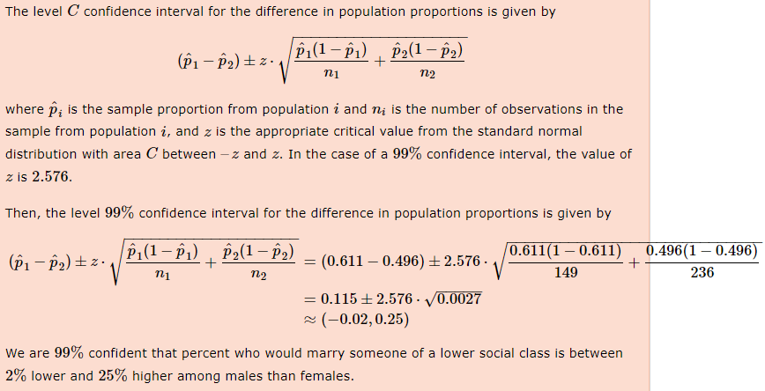

Slide 26
Two-Sample Tests for Proportions: R Commands
Continuity correction corrects for the fact that the sampling distribution of a proportion is not a continuous distribution.
It is a very slight alteration of the formula for the test statistics and the confidence interval that makes the test a little more conservative (and thus, the confidence interval a little wider). It is especially helpful when the sample size is small.

Slide 27
Two-Sample Tests for Proportions: R Commands

Slide 28
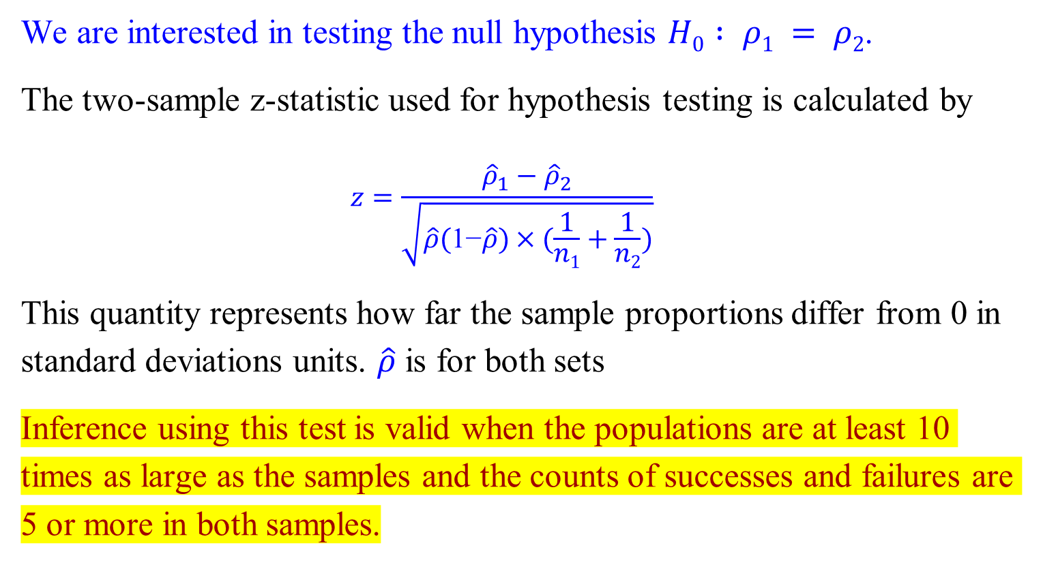
Significance Tests for Differences in Proportions
We are interested in testing the null hypothesis $H0 : ρ1 = ρ2$.
The two-sample z-statistic used for hypothesis testing is calculated by
$$z=\frac{{\hat{ρ}}_{1}−{\hat{ρ}}_{2}}{\sqrt{\hat{ρ}(\text{1−}\hat{ρ})×(\frac{1}{n1}+\frac{1}{n2})}}$$
This quantity represents how far the sample proportions differ from 0 in standard deviations units. $\hat{ρ}$ is for both sets
Inference using this test is valid when the populations are at least 10 times as large as the samples and the counts of successes and failures are 5 or more in both samples.

Slide 29

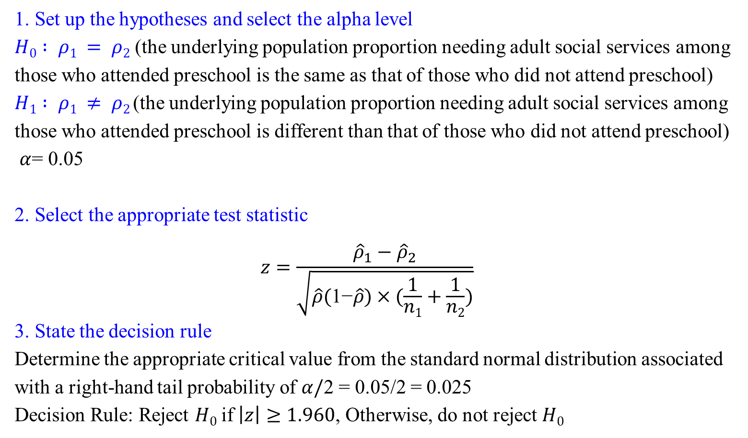
An Example: Significance Tests for Differences in Proportions
1. Set up the hypotheses and select the alpha level
$H0 : ρ1 = ρ2$ (the underlying population proportion needing adult social services among those who attended preschool is the same as that of those who did not attend preschool)
$H1 : ρ1 ≠ ρ2$(the underlying population proportion needing adult social services among those who attended preschool is different than that of those who did not attend preschool)
$α$= 0.05
2. Select the appropriate test statistic
$$z=\frac{{\hat{ρ}}_{1}−{\hat{ρ}}_{2}}{\sqrt{\hat{ρ}(\text{1−}\hat{ρ})×(\frac{1}{n1}+\frac{1}{n2})}}$$
3. State the decision rule
Determine the appropriate critical value from the standard normal distribution associated with a right-hand tail probability of $α/$2 = 0.05/2 = 0.025
Decision Rule: Reject $H0$if $\left|z\right|≥1.960$, Otherwise, do not reject $H0$

Slide 30
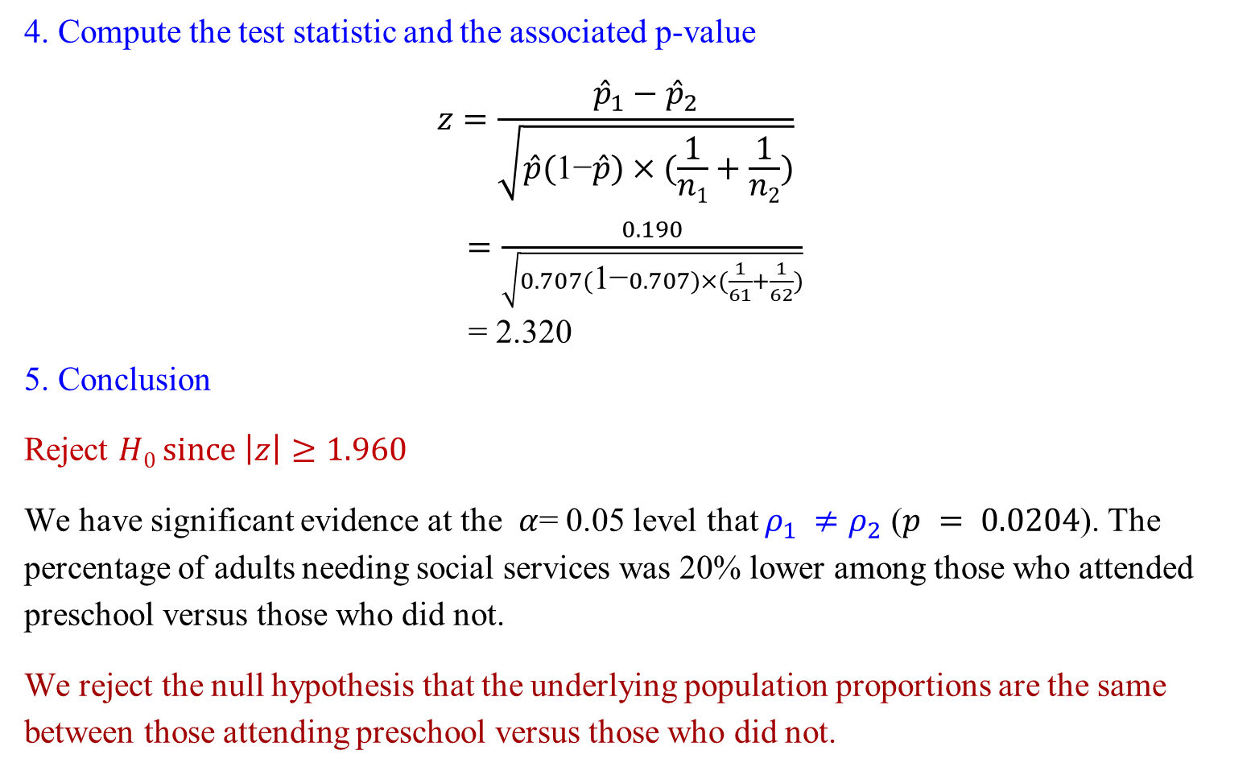
An Example: Significance Tests for Differences in Proportions
4. Compute the test statistic and the associated p-value
$$z=\frac{{\hat{p}}_{1}−{\hat{p}}_{2}}{\sqrt{\hat{p}(\text{1−}\hat{p})×(\frac{1}{n1}+\frac{1}{n2})}}$$
$=\frac{0.190}{\sqrt{0.707(\text{1−}0.707)×(\frac{1}{61}+\frac{1}{62})}}$
= 2.320
5. Conclusion
Reject $H0 since$ $\left|z\right|≥1.960$
We have significant evidence at the $α$= 0.05 level that $ρ_{1} ≠ρ_{2}$ ($p = 0.0204$). The percentage of adults needing social services was 20% lower among those who attended preschool versus those who did not.
We reject the null hypothesis that the underlying population proportions are the same between those attending preschool versus those who did not.

Slide 31
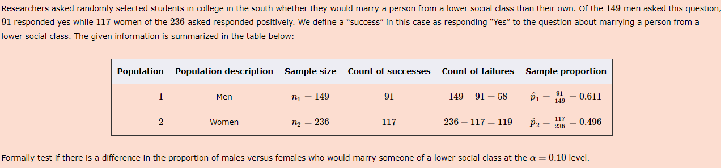
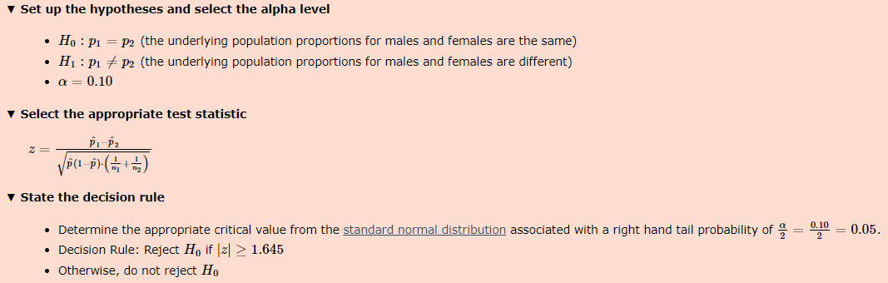
Exercise

Slide 32
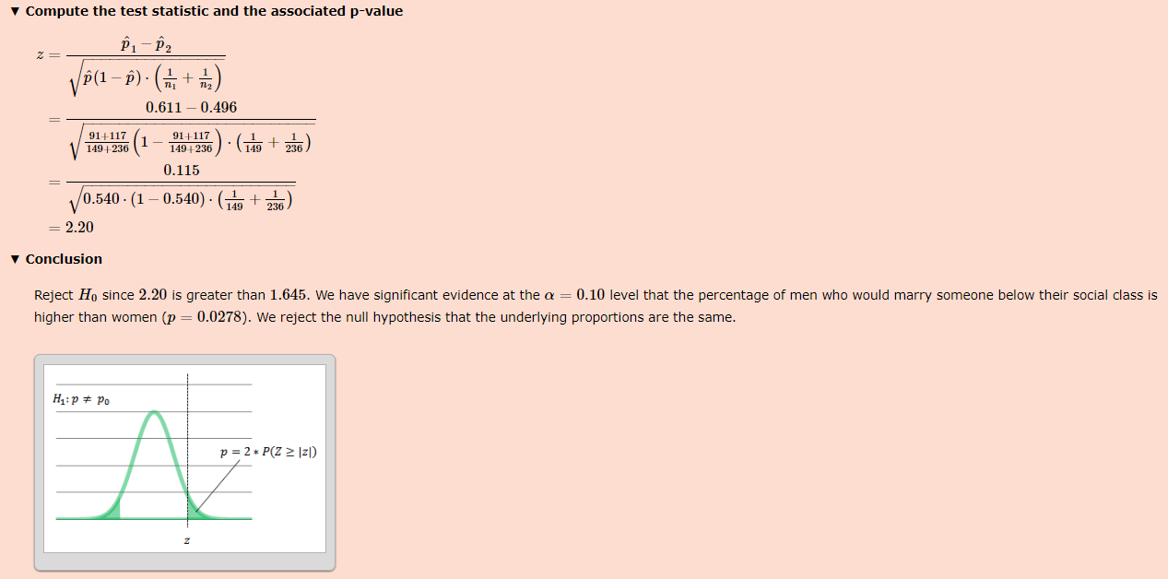

Slide 33
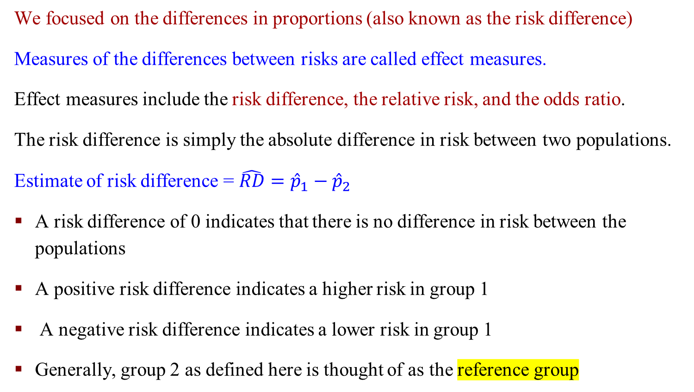
Effect Measures
We focused on the differences in proportions (also known as the risk difference)
Measures of the differences between risks are called effect measures.
Effect measures include the risk difference, the relative risk, and the odds ratio.
The risk difference is simply the absolute difference in risk between two populations.
Estimate of risk difference = $\hat{RD}={\hat{p}}_{1}−{\hat{p}}_{2}$
A risk difference of 0 indicates that there is no difference in risk between the populations
A positive risk difference indicates a higher risk in group 1
A negative risk difference indicates a lower risk in group 1
Generally, group 2 as defined here is thought of as the reference group

Slide 34
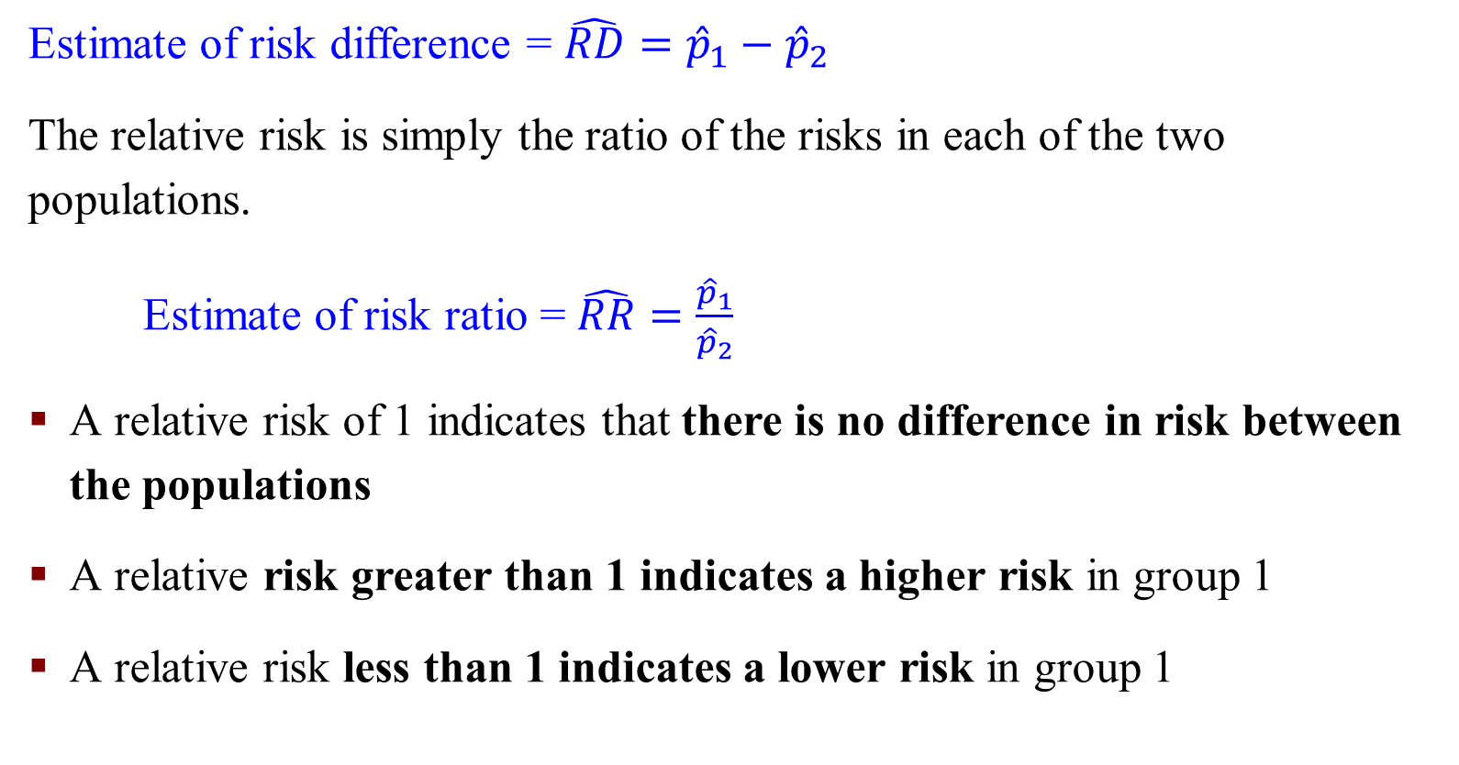
Estimate of Risk Ratio
Estimate of risk difference = $\hat{RD}={\hat{p}}_{1}−{\hat{p}}_{2}$
The relative risk is simply the ratio of the risks in each of the two populations.
Estimate of risk ratio = $\hat{RR}=\frac{{\hat{p}}_{1}}{{\hat{p}}_{2}}$
A relative risk of 1 indicates that there is no difference in risk between the populations
A relative risk greater than 1 indicates a higher risk in group 1
A relative risk less than 1 indicates a lower risk in group 1

Slide 35
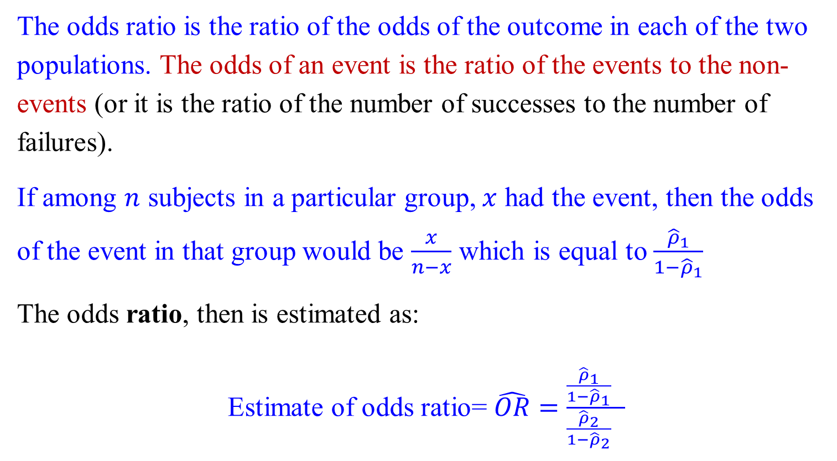
Effect Measures – Odds Ratio
The odds ratio is the ratio of the odds of the outcome in each of the two populations. The odds of an event is the ratio of the events to the non-events (or it is the ratio of the number of successes to the number of failures).
If among $n$ subjects in a particular group, $x$ had the event, then the odds of the event in that group would be $\frac{x}{n−x}$ which is equal to $\frac{{\hat{ρ}}_{1}}{1−{\hat{ρ}}_{1}}$
The odds ratio, then is estimated as:
Estimate of odds ratio= $\hat{OR}=\frac{\frac{{\hat{ρ}}_{1}}{1−{\hat{ρ}}_{1}} }{\frac{{\hat{ρ}}_{2}}{1−{\hat{ρ}}_{2}} }$

Slide 36
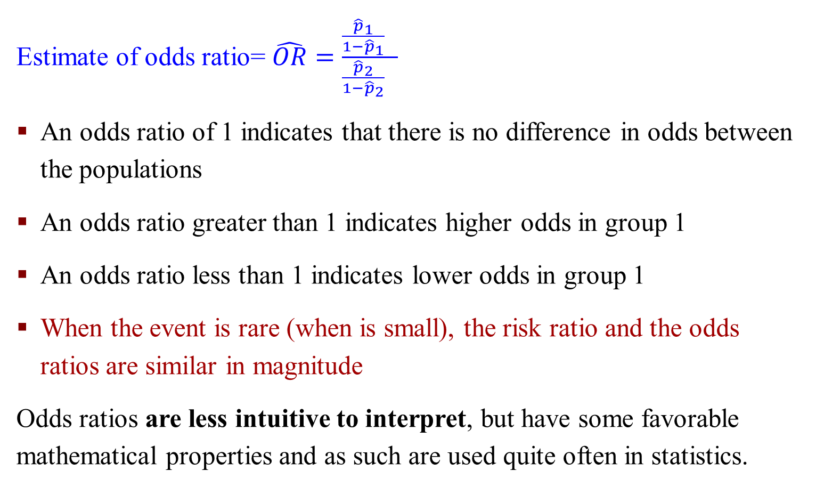
Effect Measures – Odds Ratio
Estimate of odds ratio= $\hat{OR}=\frac{\frac{{\hat{p}}_{1}}{1−{\hat{p}}_{1}} }{\frac{{\hat{p}}_{2}}{1−{\hat{p}}_{2}} }$
An odds ratio of 1 indicates that there is no difference in odds between the populations
An odds ratio greater than 1 indicates higher odds in group 1
An odds ratio less than 1 indicates lower odds in group 1
When the event is rare (when is small), the risk ratio and the odds ratios are similar in magnitude
Odds ratios are less intuitive to interpret, but have some favorable mathematical properties and as such are used quite often in statistics.

Slide 37
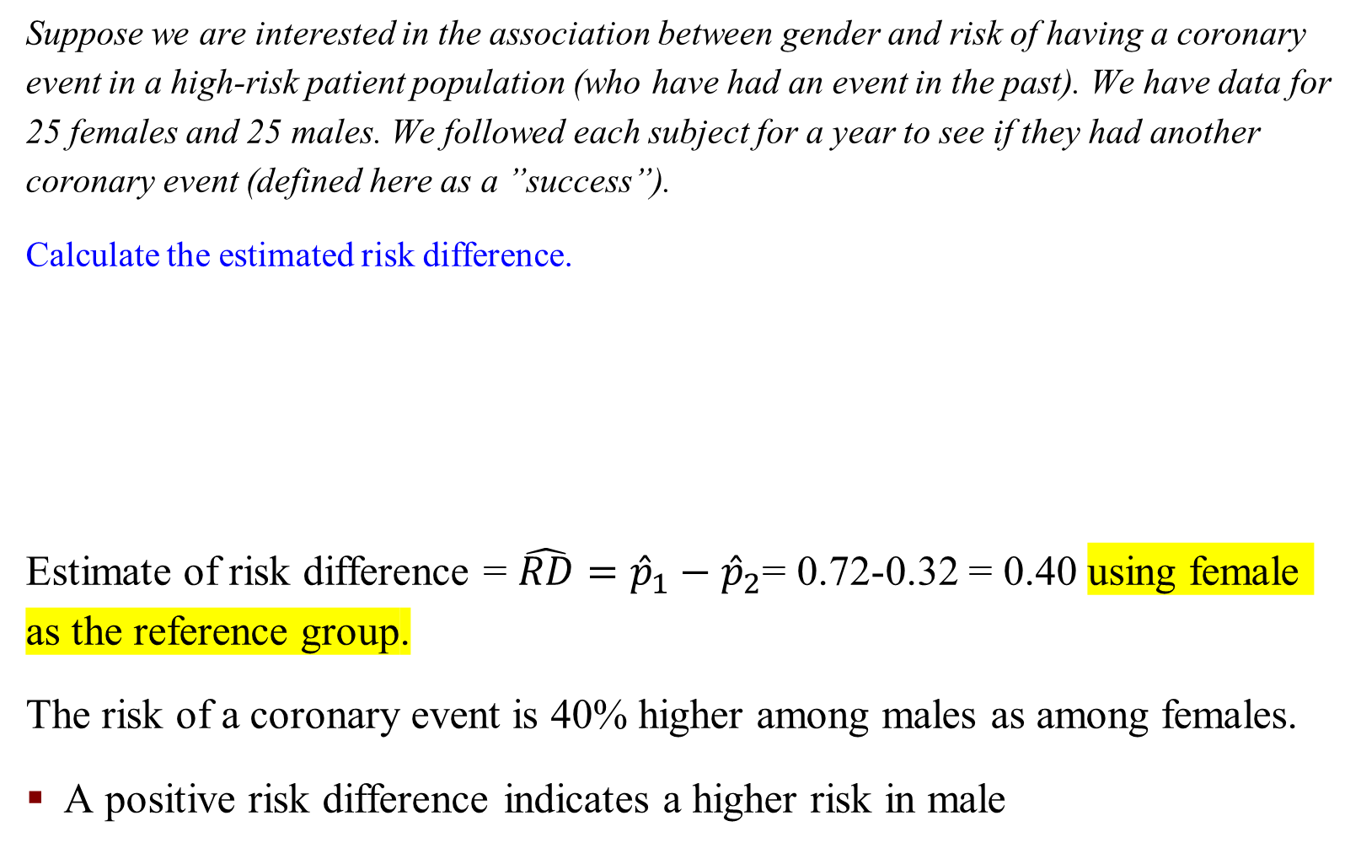
An Example: Estimate of Risk Difference
Suppose we are interested in the association between gender and risk of having a coronary event in a high-risk patient population (who have had an event in the past). We have data for 25 females and 25 males. We followed each subject for a year to see if they had another coronary event (defined here as a ”success”).
Calculate the estimated risk difference.
Estimate of risk difference = $\hat{RD}={\hat{p}}_{1}−{\hat{p}}_{2}$= 0.72-0.32 = 0.40 using female as the reference group.
The risk of a coronary event is 40% higher among males as among females.
A positive risk difference indicates a higher risk in male

Slide 38
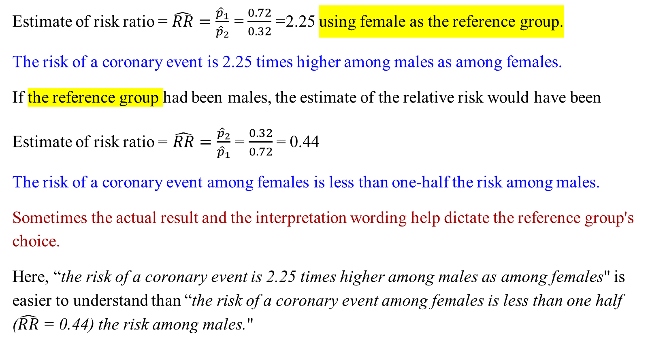
An Example: Estimate of Risk Ratio
Estimate of risk ratio = $\hat{RR}=\frac{{\hat{p}}_{1}}{{\hat{p}}_{2}}$ = $\frac{0.72}{0.32}$ =2.25 using female as the reference group.
The risk of a coronary event is 2.25 times higher among males as among females.
If the reference group had been males, the estimate of the relative risk would have been
Estimate of risk ratio = $\hat{RR}=\frac{{\hat{p}}_{2}}{{\hat{p}}_{1}}$ = $\frac{0.32}{0.72}$= 0.44
The risk of a coronary event among females is less than one-half the risk among males.
Sometimes the actual result and the interpretation wording help dictate the reference group's choice.
Here, “the risk of a coronary event is 2.25 times higher among males as among females" is easier to understand than “the risk of a coronary event among females is less than one half ($\hat{RR}$= 0.44) the risk among males."

Slide 39
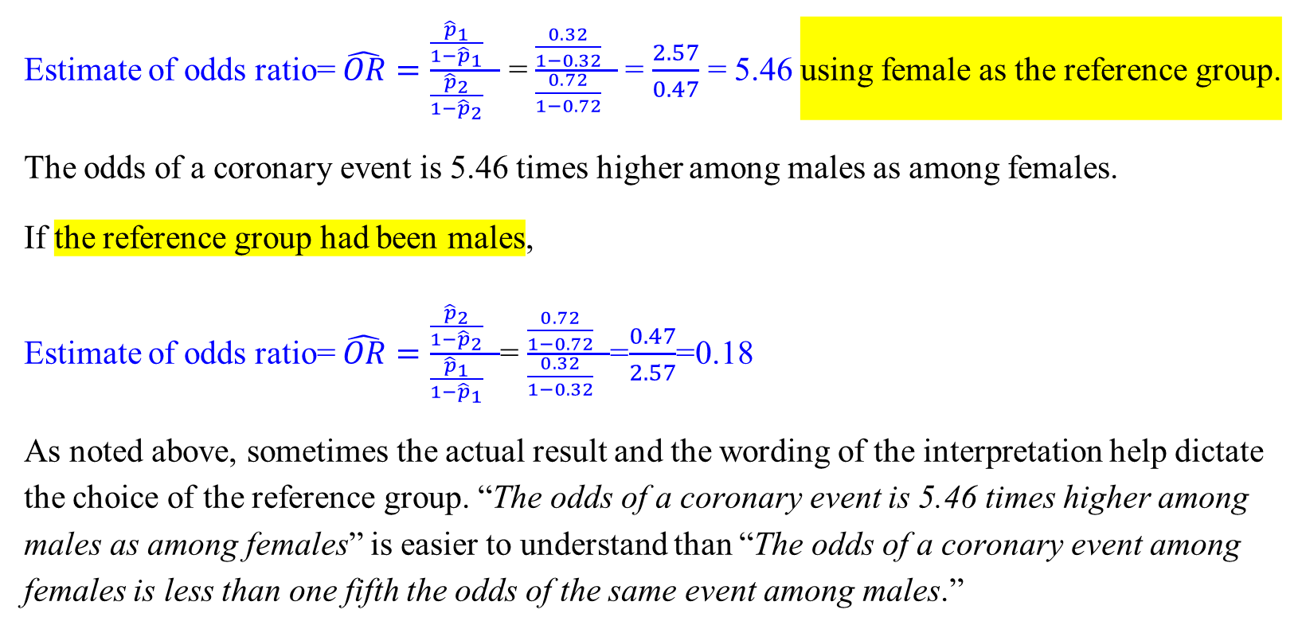
An Example: Estimate of Risk Ratio
Estimate of odds ratio= $\hat{OR}=\frac{\frac{{\hat{p}}_{1}}{1−{\hat{p}}_{1}} }{\frac{{\hat{p}}_{2}}{1−{\hat{p}}_{2}} }$ = $\frac{\frac{0.32}{1−0.32} }{\frac{0.72}{1−0.72} }$= $\frac{2.57}{0.47}$ = 5.46 using female as the reference group.
The odds of a coronary event is 5.46 times higher among males as among females.
If the reference group had been males,
Estimate of odds ratio= $\hat{OR}=\frac{\frac{{\hat{p}}_{2}}{1−{\hat{p}}_{2}} }{\frac{{\hat{p}}_{1}}{1−{\hat{p}}_{1}} }$= $\frac{\frac{0.72}{1−0.72} }{\frac{0.32}{1−0.32} }$=$\frac{0.47}{2.57}$=0.18
As noted above, sometimes the actual result and the wording of the interpretation help dictate the choice of the reference group. “The odds of a coronary event is 5.46 times higher among males as among females” is easier to understand than “The odds of a coronary event among females is less than one fifth the odds of the same event among males.”

